Slide 1
Ecospace Package in R

Slide 2
ecospace -package
An R Package that implements stochastic simulations of community assembly (ecological diversification ) using customizable ecospace frameworks (functional trait space).
Simulations model the ‘neutral’ , ‘redundancy’, ‘partitioning’ and ‘expansion’ models of Bush and Novack- Gottshall(2012) and Novack-Gottshall(2016).

Slide 3
Monte Carlo Simulations
Monte Carlo methods are a broad class of computational algorithms that reply on repeated random sampling to obtain numerical results.
Monte Carlo are Simulations evolving randomly.
Tossing of a coin
Approximating value of Pi.

Slide 4
Create_ecospace ( )
Create ecospace frameworks (functional trait spaces) of specified structure.
Arguments:
nchar - Number of life habit characters (functional traits)
char.state - Numeric vector of number of character states in each character.
char.type - Character string listing type for each character
Allowed types include:
numeric for numeric and binary characters,
ord.num for ordered numeric characters,
ord.fac for ordered factor characters, or
factor for factor characters.

Slide 5
create_ecospace
char.names - Optional character string listing character names.
state.names - Optional character string listing character states.
constraint- Positive integer specifying the maximum number of “multiple presences” to allow if using multistate binary/numeric character types.
Weight.file- Relative weights for ecospace character-state probabilities.
NOTE : -

Slide 6
Calc_metrics
Calculates ecological disparity and functional diversity statistics such as :-
H - Life habit richness, the number of functionally unique trait combinations.
M - Maximum pairwise distance between in functional trait space.
FRic - Functional richness, the minimum convex hull volume in multidimensional principal coordinate analysis (PCoA) trait space coordination.
FDiv - Functional divergence, the mean distance of species from the PCoA trait space centroid.
D - Mean pairwise distance between the species in functional trait space.
V - Total Variance, the sum of variances for each functional trait across species. When using factor or ordered factor character types, this statistic cannot be measured and the is left blank, with a warning.
FDis - Functional dispersion, the deviance of species from the circle with radius equal to mean distance from PCoA trait space centroid.
FEve- the evenness of the abundance distribution in a functional trait space.

Slide 7
Gower’s Distance
The Gower distance is a metric that measures the dissimilarity of two items with mixed numeric and non-numeric data. Gower distance is also called Gower dissimilarity.
If the element is numeric, the term is the absolute value of the difference divided by the range.
If the element is non-numeric the term is 1 if the elements are different or the term is 0 if the elements are the same. The Gower distance is the average of the terms.

Slide 8
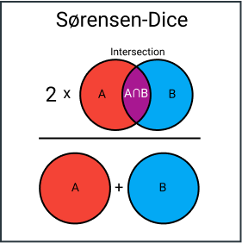
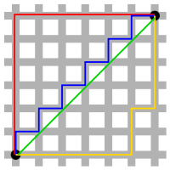
Gower’s Distance
Quantitative (interval): range-normalized Manhattan distance
Ordinal: variable is first ranked, then Manhattan distance is used with a special adjustment for ties.
Nominal: variables of k categories are first converted into k binary columns and then the Dice coefficient is used.

Slide 9
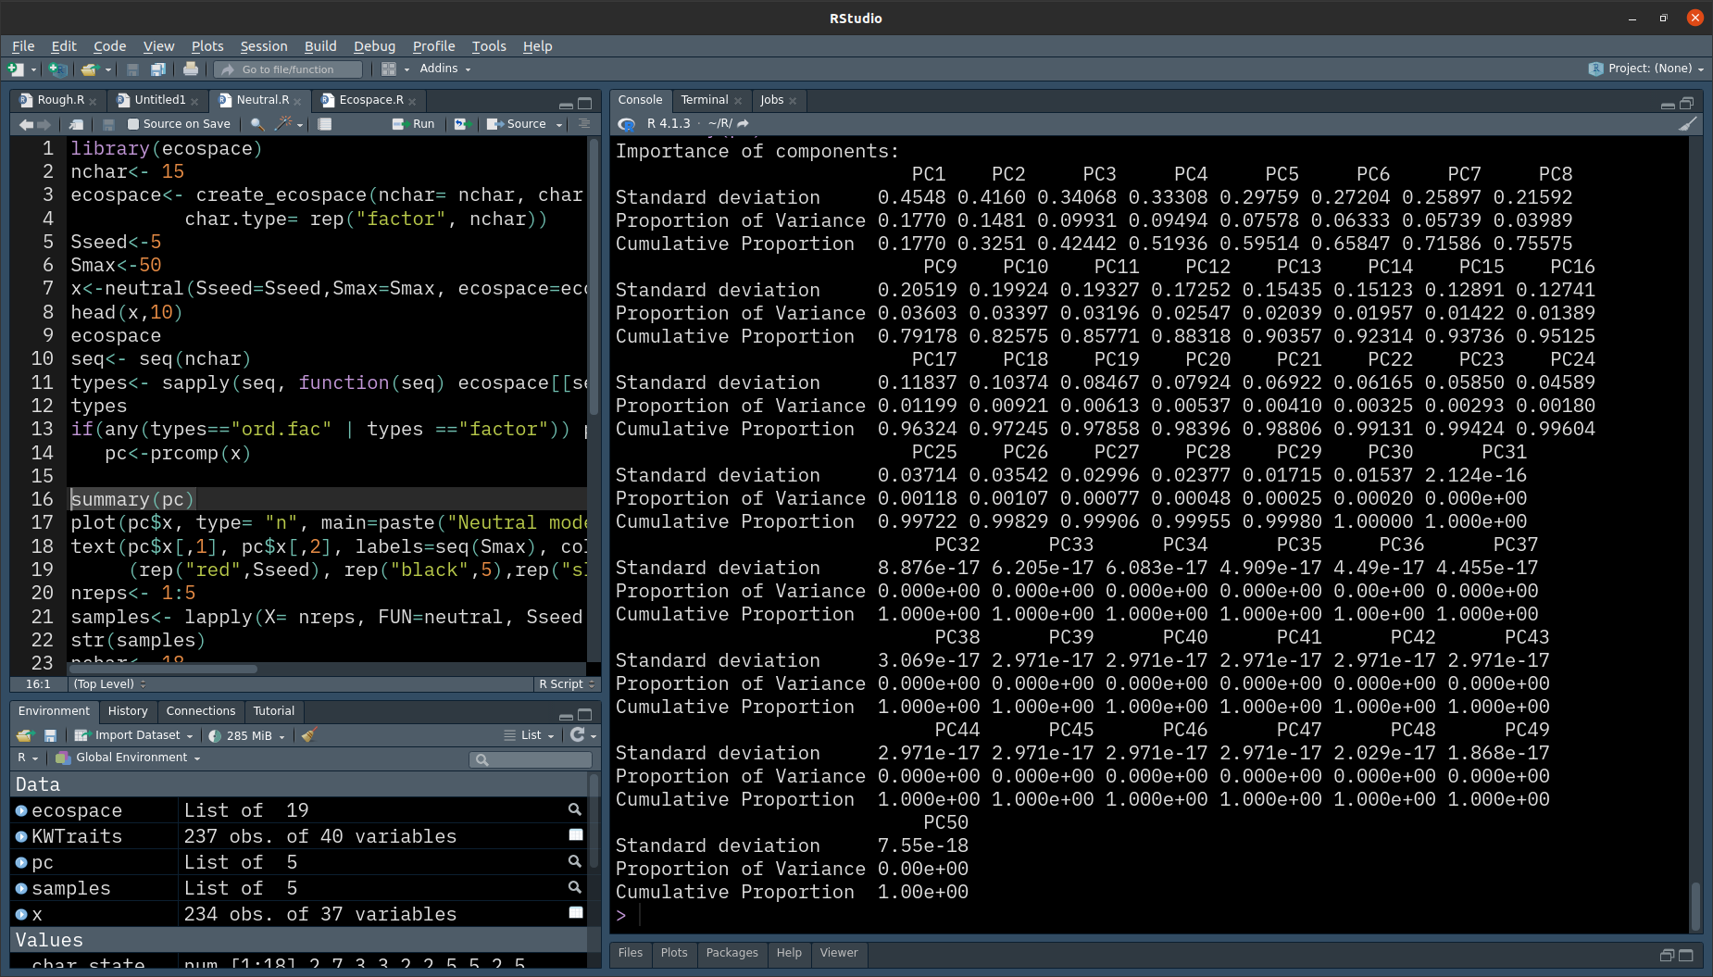
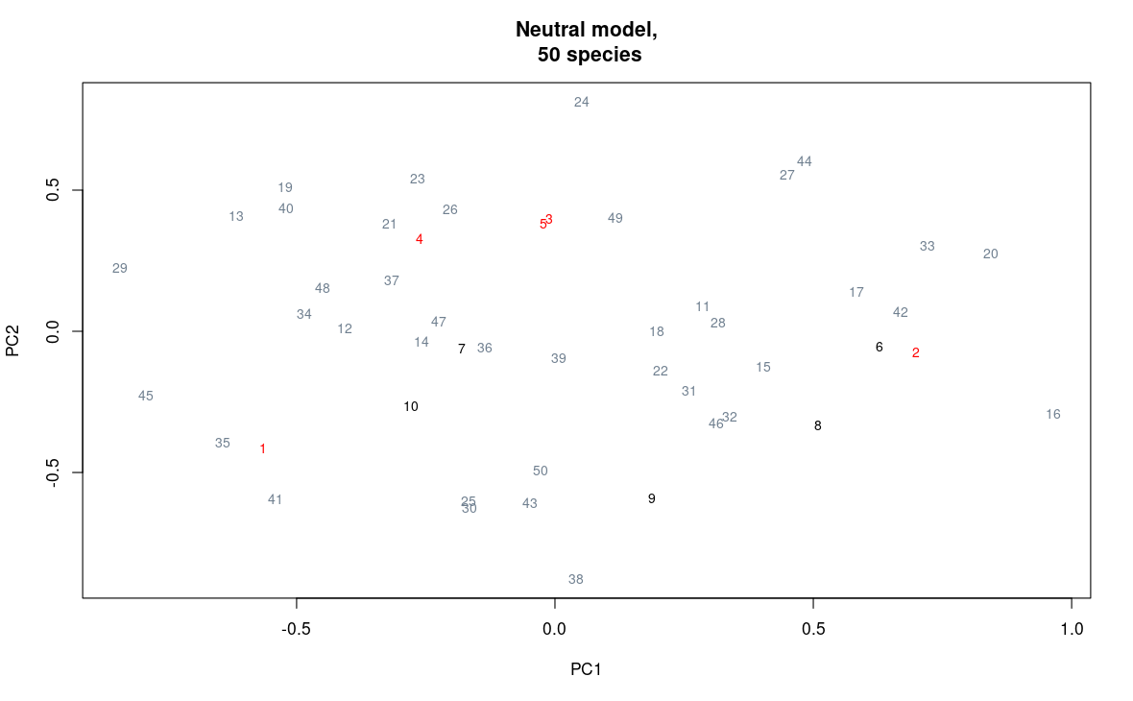
PCA
Dimensionality reduction technique.
We take the projection along the maximum variance, gives the Principal component 1.

Slide 10
Simulations
Ecospace
Neutral Model
Redundancy Model
Partitioning Model
Expansion

Slide 11
Redundancy Model
Pick one existing species at random and create a new species using that species' characters as a template. A character is modified (using a random draw from the ecospace framework) according to the strength parameter. Default strength = 1 always implements the redundancy rule, whereas strength = 0 never implements it (essentially making the simulation follow the neutral rule.)

Slide 12
Neutral Model
Implement Monte Carlo simulation of a biota undergoing ecological diversification using the neutral rule. Can be used as a simple permutation test (draw species at random with replacement from provided species pool) if set Sseed equal to Smax.

Slide 13
Database collection from PBDB

Slide 14
Thanks!
ANY QUESTIONS?

Slide 15
CREDITS
Special thanks to all the people who made and released these awesome resources for free:
Presentation template by SlidesCarnival
Photographs by Unsplash

Slide 16
Roadmap
Blue is the colour of the clear sky and the deep sea
Red is the colour of danger and courage
Black is the color of ebony and of outer space
1
3
5
2
4
6
Yellow is the color of gold, butter and ripe lemons
White is the color of milk and fresh snow
Blue is the colour of the clear sky and the deep sea

Slide 17
Timeline
Blue is the colour of the clear sky and the deep sea
Red is the colour of danger and courage
Black is the color of ebony and of outer space
Yellow is the color of gold, butter and ripe lemons
White is the color of milk and fresh snow
Blue is the colour of the clear sky and the deep sea
JAN
FEB
MAR
APR
MAY
JUN
JUL
AUG
SEP
OCT
NOV
DEC
Yellow is the color of gold, butter and ripe lemons
White is the color of milk and fresh snow
Blue is the colour of the clear sky and the deep sea
Red is the colour of danger and courage
Black is the color of ebony and of outer space
Yellow is the color of gold, butter and ripe lemons

Slide 18
Funnel
AWARENESS
Insert your content
DISCOVERY
Insert your content
EVALUATION
Insert your content
INTENT
Insert your content
PURCHASE
Insert your content
LOYALTY
Insert your content

